Slide 1
Failure-Aware and Confidence-Calibrated Adaptive Retrieval-Augmented Generation System 23CSE399 Project Phase 1 – Approval Presentation Team ID: 23UG031 Panel No.:20
S.No | Reg.No | Name of the Student | Branch
1 | BL.EN.U4CSE23246 | Siddhartha Ravva | CSE
2 | BL.EN.U4CSE23206 | Aman Aggarwal | CSE
3 | BL.EN.U4CSE23222 | Harsh Vardhan Singh | CSE
4 | BL.EN.U4CSE23043 | Pratyush Swain | CSE
Project Guide:Dr. Sajitha Krishnan
Assistant Professor
Panel Members : Dr. Peeta Basa Pati , Dr. Nidhin Prabhakar

Slide 2
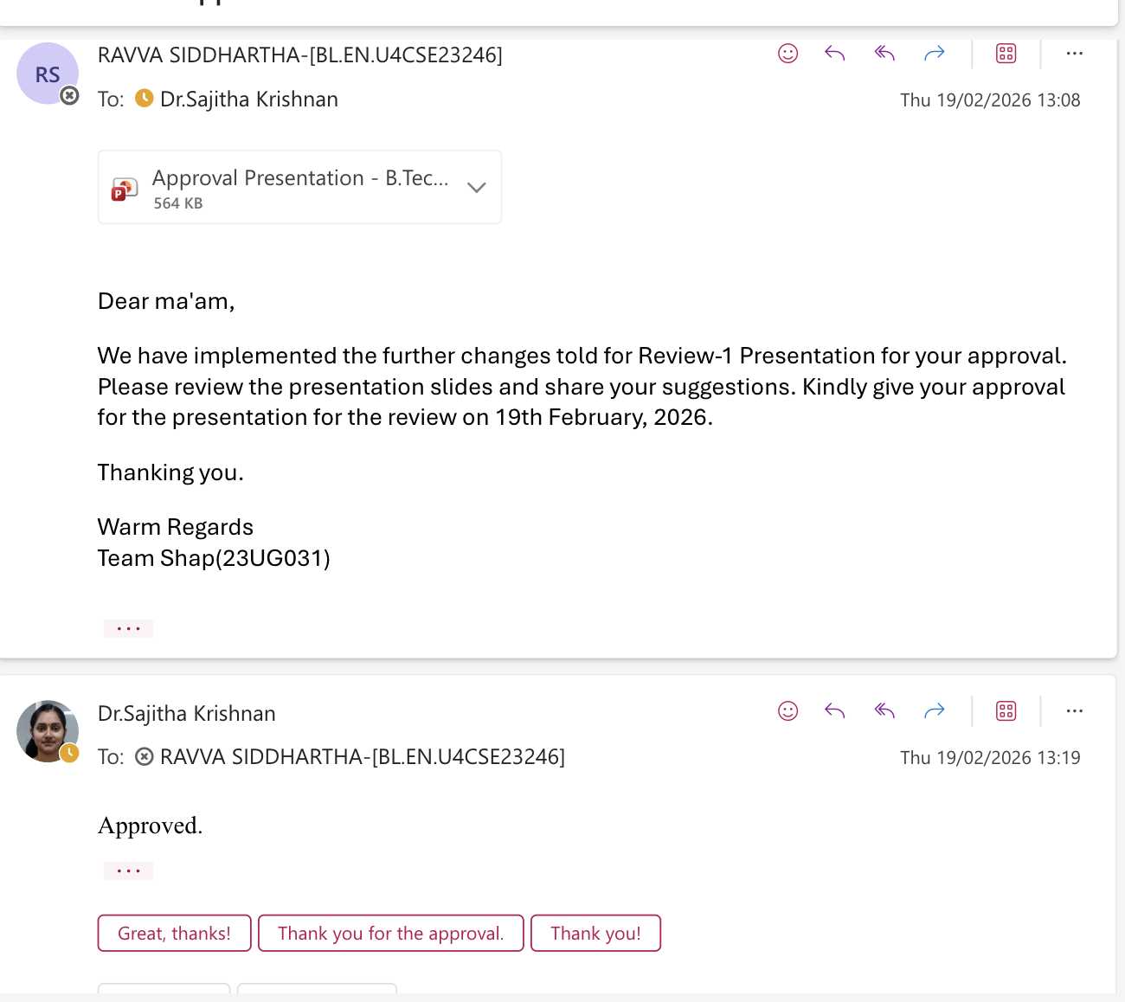
Approval Mail

Slide 3
Agenda
Problem Statement
Research Gaps
Literature Survey
Objectives
Architecture
Functionalities
Software Requirements
Project Timeline
Conclusion
References

Slide 4
Introduction - Problem Statement
RAG retrieves documents from external sources by converting queries and documents into embeddings and comparing similarity.
Existing systems rank retrieved documents based solely on similarity scores, without evaluating result quality.
Relying only on similarity ranking does not provide insight into how reliable or trustworthy the retrieved results are.
As a result, semantically weak, inconsistent, or partially irrelevant documents may be included in the context without any indication of error.
Standard RAG approaches do not include a mechanism to quantify retrieval reliability or flag potential retrieval failure before generation.
Multi-signal retrieval assessment, such as evaluating similarity strength, stability of top-k similarity patterns, and semantic agreement among retrieved documents, is not addressed in current work.

Slide 5
Research Gaps
Over-reliance on raw similarity ranking​
No explicit retrieval reliability metric​
No explicit top-k similarity stability modeling​
No explicit multi-signal retrieval failure framework​

Slide 6
Literature Survey
S.No. | Authors name(s) | Full title of the paper with year | Inference from the paper | Open Problem (For proposed work)
1 | H. Soudani, E. Kanoulas, and F. Hasibi | Why Uncertainty Estimation Methods Fall Short in Retrieval-Augmented Generation: An Axiomatic Analysis, 2025 | Defines axioms for reliable uncertainty estimation in RAG. Shows token probability and entropy methods ignore retrieval quality and grounding. Emphasizes need for retrieval-aware uncertainty estimation. Evaluation Metrics Used: Expected Calibration Error (ECE), Brier Score, Negative Log Likelihood (NLL), and AUROC. | Does not propose a practical mechanism to compute retrieval reliability using measurable signals such as similarity score consistency, retrieval variance, or agreement.
2 | L. Ngartera, S. Nadarajah, and R. Koina | Bayesian RAG: Uncertainty-Aware Retrieval for Reliable Financial Question Answering, 2026 | Uses Bayesian embeddings to model retrieval uncertainty and improve reliability. Evaluation Metrics Used: Accuracy, F1 Score, Expected Calibration Error (ECE), Brier Score, Negative Log Likelihood (NLL), and AUROC. | Does not explicitly detect retrieval failures using similarity consistency or agreement signals.

Slide 7
Literature Survey
S.No. | Authors name(s) | Full title of the paper with year | Inference from the paper | Open Problem (For proposed work)
3 | Michael Oehri, Jannis Vamvas, et al. | Trusted Uncertainty in Large Language Models: A Unified Framework for Confidence Calibration and Risk-Controlled Refusal, 2025 | Proposes unified confidence framework using likelihood, entropy, and self-consistency signals. Enables calibrated confidence estimation and risk-controlled refusal in LLM responses. Evaluation Metrics Used: Expected Calibration Error (ECE), Brier Score, Negative Log Likelihood (NLL) | Does not incorporate retrieval reliability estimation or similarity-based retrieval failure signals in RAG systems.
4 | Y. Gao, Y. Xiong, X. Gao, et al. | Retrieval-Augmented Generation for Large Language Models: A Survey, 2023 | Provides comprehensive overview of RAG architecture, retrieval methods, and reliability challenges. Identifies uncertainty estimation and retrieval reliability as key limitations. Evaluation Metrics Used: Exact Match (EM), F1 Score, Accuracy, BLEU, ROUGE | Does not propose practical methods to quantify retrieval reliability using similarity consistency or agreement signals.

Slide 8
Literature Survey
S.No. | Authors name(s) | Full title of the paper with year | Inference from the paper | Open Problem (For proposed work)
5 | S. Es, J. James, L. Espinosa-Anke, and S. Schockaert | RAGAS: Automated Evaluation of Retrieval-Augmented Generation, 2023 | Introduces metrics such as context relevance, faithfulness, and grounding to evaluate RAG performance. Enables automated evaluation without human annotation. Evaluation Metrics Used: Context Precision, Context Recall, Faithfulness | Provides evaluation metrics but does not detect retrieval failures or estimate retrieval reliability dynamically during inference.
6 | V. Karpukhin et al. | Dense Passage Retrieval for Open-Domain Question Answering, 2020 | Introduces dense retrieval using neural encoders and embedding similarity scoring. Improves retrieval accuracy over traditional keyword-based methods. Evaluation Metrics Used: Recall-k (e.g., Recall@20, Recall@100), Top-k Retrieval Accuracy, Exact Match (EM), and F1 Score. | Uses similarity scores for document ranking but does not analyze similarity patterns to estimate retrieval reliability or detect retrieval failures.

Slide 9
Literature Survey
S.No. | Authors name(s) | Full title of the paper with year | Inference from the paper | Open Problem (For proposed work)
7 | S.-Q. Yan, J.-C. Gu, Y. Zhu, and Z.-H. Ling | Corrective Retrieval-Augmented Generation, 2024 | Introduces a retrieval evaluator to assess relevance and correctness of retrieved documents. Improves retrieval quality by correcting weak or irrelevant retrieval results. Evaluation Metrics Used: Exact Match (EM), F1 Score, Accuracy, Recall-k, Expected Calibration Error (ECE) | Requires a separate 'evaluator' model to trigger web searches, adding architectural complexity. It corrects retrieval but doesn't quantify a confidence score for the user.
8 | P. Lewis et al. | Retrieval-Augmented Generation for Knowledge-Intensive NLP Tasks, 2020 | Introduces RAG framework combining dense retrieval and generation using embedding similarity. Improves factual accuracy by grounding responses in retrieved knowledge. Evaluation Metrics Used: Exact Match (EM), F1 Score, Accuracy, Perplexity | Does not estimate retrieval reliability or detect weak retrieval before generation.

Slide 10
Literature Survey
S.No. | Authors name(s) | Full title of the paper with year | Inference from the paper | Open Problem (For proposed work)
9 | A. Asai, Z. Wu, Y. Wang, A. Sil, and H. Hajishirzi | Self-RAG: Learning to Retrieve, Generate, and Critique through Self-Reflection, 2023 | Introduces reflection tokens to evaluate relevance and usefulness of retrieved documents. Enables the model to critique retrieval quality and improve response grounding. Evaluation Metrics Used: Exact Match (EM), F1 Score, Accuracy, Human Evaluation | Relies on 'reflection tokens' and fine-tuning, which increases computational cost and latency. It does not assess the retriever's raw stability before generation begins.
10 | O. Khattab and M. Zaharia | ColBERT: Efficient and Effective Passage Search via Contextualized Late Interaction over BERT, 2020 | Introduces token-level late interaction similarity scoring using contextual embeddings. Improves retrieval precision and semantic matching between query and documents. Evaluation Metrics Used: Mean Reciprocal Rank (MRR), Recall-k, Normalized Discounted Cumulative Gain | Does not compute retrieval reliability or detect weak retrieval using similarity consistency signals.

Slide 11
Literature Survey
S.No. | Authors name(s) | Full title of the paper with year | Inference from the paper | Open Problem (For proposed work)
11 | J. Song, X. Wang, J. Zhu, et al. | RAG-HAT: A Hallucination-Aware Tuning Pipeline for LLM in Retrieval-Augmented Generation, 2024 | Introduces hallucination-aware tuning pipeline using retrieval-guided training signals. Improves factual grounding and reliability of generated responses in RAG systems. | Does not explicitly estimate retrieval reliability or detect weak retrieval using similarity consistency signals.
12 | H. Ding, L. Pang, Z. Wei, H. Shen, and X. Cheng | Rowen: Adaptive Retrieval-Augmented Generation for Hallucination Mitigation in LLMs, 2025 | Introduces adaptive retrieval mechanism to dynamically improve document choice. Enhances retrieval relevance and reduces hallucinations in generated responses. | Does not compute retrieval reliability scores using similarity consistency or retrieval agreement signals.

Slide 12
Literature Survey
S.No. | Authors name(s) | Full title of the paper with year | Inference from the paper | Open Problem (For proposed work)
13 | Z. Sun, X. Zang, K. Zheng, et al. | ReDeEP: Detecting Hallucination in Retrieval-Augmented Generation via Mechanistic Interpretability, 2025 | Uses mechanistic interpretability to analyze internal model activations during generation. Enables detection of hallucinations caused by weak or incorrect grounding. Evaluation Metrics Used: Hallucination Detection Accuracy, Precision, Recall | Focuses on generation analysis but does not estimate retrieval reliability using similarity consistency or agreement signals.

Slide 13
Objectives
The current RAG models employ similarity scores for ranking but lack the ability to identify retrieval failure explicitly.
Similarity score alone does not guarantee retrieval correctness or consistency.
The recent models like Self-RAG and CRAG (Corrective Retrieval-Augmented Generation)assess the quality of retrieval but lack the ability to compute retrieval reliability explicitly from measurable signals.
This results in the potential of poor retrieval going unnoticed, thereby causing unreliable responses.
There is a requirement for a system that computes the retrieval failure signal based on similarity score, top-k consistency, and retrieval agreement.
The plan for the implementation of the estimation of the retrieval failure signal for the identification of retrieval failures is proposed in this work.

Slide 14
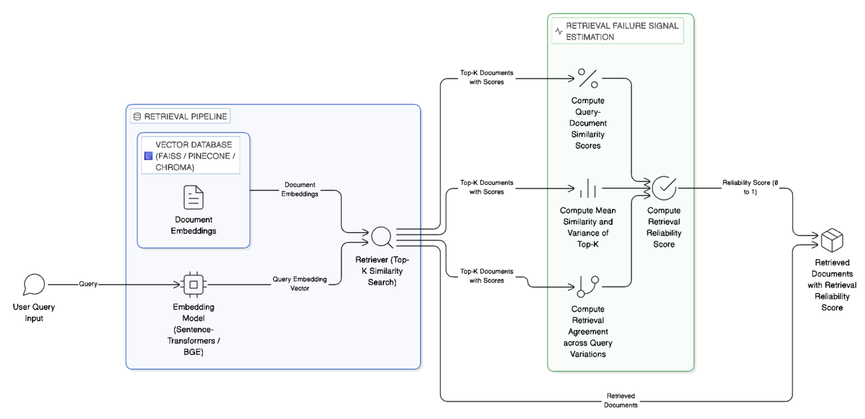
Architecture of the Proposed System

Slide 15
Functionalities of the Proposed System
Core RAG Pipeline
• Convert input query into dense embedding
• Retrieve top-k documents using cosine similarity
• Compute and rank query–document similarity scores
• Provide retrieved context for generation
Retrieval Failure Score Module
• Compute similarity magnitude of top-k documents
• Analyse top-k similarity consistency
• Measure retrieval agreement among documents
• Aggregate signals into a retrieval reliability score
• Detect weak or unreliable retrieval before generation

Slide 16
Software/Tools Requirements
Programming Language:
Python
Frameworks:
HuggingFace Transformers
Sentence-Transformers
LangChain / LlamaIndex
FAISS / ChromaDB
Models:
Embedding Model: BGE-large or MiniLM , GloVe ,Word2Vec
Generator Model: Mistral-7B (future integration) , Phi-3 , Phi-2 , Llama-3
Platform:
Kaggle GPU Environment

Slide 17
Timeline
Literature Survey
System Architecture Design Finalization
Abstract Submission
Embedding Model Integration and Vector Database Setup
Basic Retrieval Pipeline Implementation
Implementation of Failure Aware Signals
30/4/2026
5/4/2026
5/2/2026
20/3/2026
5/3/2026
17/2/2026

Slide 18
Conclusion
This work proposes a failure-aware RAG framework to improve system reliability.
This phase focuses on detecting retrieval failures using similarity score, top-k consistency, and retrieval agreement signals.
The system estimates retrieval reliability and enables early detection of weak retrieval.
This forms the foundation for future confidence estimation and adaptive RAG systems.

Slide 19
References
[1] H. Soudani, E. Kanoulas, and F. Hasibi, “Why Uncertainty Estimation Methods FallShort in Retrieval-Augmented Generation: An Axiomatic Analysis,” arXiv preprintarXiv:2505.07459, 2025. [Online]. Available: http://arxiv.org/abs/2505.07459
[2] M. Oehri et al., “Trusted Uncertainty in Large Language Models: A UnifiedFramework for Confidence Calibration and Risk-Controlled Refusal,” arXiv preprintarXiv:2509.01455, 2025.
[3] L. Ngartera, S. Nadarajah, and R. Koina, “Bayesian RAG: Uncertainty-AwareRetrieval for Reliable Financial Question Answering,” Frontiers in Artificial Intelligence,vol. 8, 2026, doi: 10.3389/frai.2025.1668172.
[4] Y. Gao, Y. Xiong, X. Gao, K. Jia, J. Pan, Y. Bi, Y. Dai, J. Sun, H. Wang, and H.Wang, “Retrieval-Augmented Generation for Large Language Models: A Survey,” arXivpreprint arXiv:2312.10997, 2023.

Slide 20
References
[5] S. Es, J. James, L. Espinosa-Anke, and S. Schockaert, “RAGAS: Automated Evaluation of Retrieval-Augmented Generation,” arXiv preprint arXiv:2309.15217, 2023.
[6] V. Karpukhin et al., “Dense Passage Retrieval for Open-Domain Question Answering,” in Proceedings of the 2020 Conference on Empirical Methods in Natural Language Processing (EMNLP), 2020, pp. 6769–6781.
[7] S.-Q. Yan, J.-C. Gu, Y. Zhu, and Z.-H. Ling, “Corrective Retrieval-Augmented Generation,” arXiv preprint arXiv:2401.15884, 2024.
[8] P. Lewis et al., “Retrieval-Augmented Generation for Knowledge-Intensive NLP Tasks,” in Advances in Neural Information Processing Systems (NeurIPS), vol. 33, 2020, pp. 9459–9474.

Slide 21
References
[9] A. Asai, Z. Wu, Y. Wang, A. Sil, and H. Hajishirzi, “Self-RAG: Learning to Retrieve,Generate, and Critique through Self-Reflection,” arXiv preprint arXiv:2310.11511, 2023.
[10] O. Khattab and M. Zaharia, “ColBERT: Efficient and Effective Passage Search viaContextualized Late Interaction over BERT,” in Proceedings of the 43rd International ACMSIGIR Conference on Research and Development in Information Retrieval, 2020, pp. 39–48, doi:10.1145/3397271.3401075.
[11] J. Song, X. Wang, J. Zhu, Y. Wu, X. Cheng, R. Zhong, and C. Niu, “RAG-HAT: AHallucination-Aware Tuning Pipeline for LLM in Retrieval-Augmented Generation,” arXivpreprint, 2024.
[12] H. Ding, L. Pang, Z. Wei, H. Shen, and X. Cheng, “Rowen: Adaptive Retrieval-AugmentedGeneration for Hallucination Mitigation in Large Language Models,” arXiv preprint, 2025.
[13] Z. Sun, X. Zang, K. Zheng, et al., “ReDeEP: Detecting Hallucination in Retrieval-Augmented Generation via Mechanistic Interpretability,” 2025.

Slide 22
THANK YOU

